Slide 1
ADVANCING THE KINGDOM FOR MAXIMUM IMPACT
JUNE 10, 2022

Slide 2
ACTS 20:28
Keep watch over yourselves and all the flock of which the Holy Spirit has made you overseers. Be shepherds of the church of God, which he bought with his own blood.

Slide 3
Where you can find all the documents: https://ministryarchitects.com/advancing-the-kingdom/

Slide 4
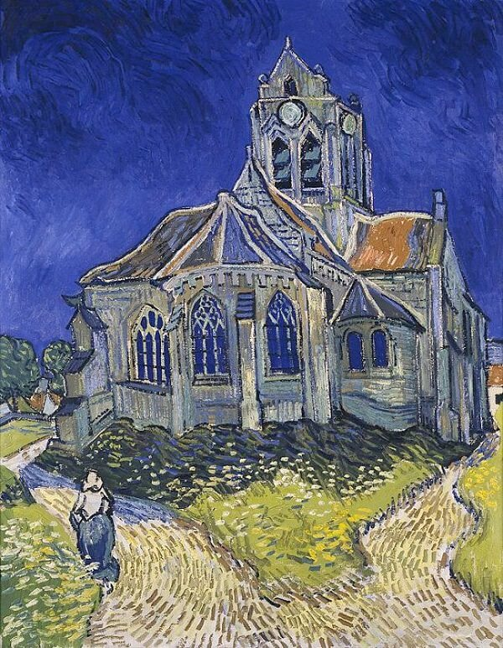
The Church at Auvers, 1890, 1888 by Vincent Van Gogh
Knowing Your Church

Slide 5
Knowing Your Target

Slide 6
Let’s take a look…

Slide 7
James 2:14-18
What good is it, my brothers, if someone claims to have faith, but has no deeds? Can such faith save him? Suppose a brother or sister is without clothes and daily food. If one of you tells him, “Go in peace; stay warm and well fed,” but does not provide for his physical needs, what good is that? So too, faith by itself, if it does not result in action, it is dead. But someone will say, “You have faith and I have deeds.” Show me your faith without deeds, and I will show you my faith by my deeds.

Slide 8
break

Slide 9
Breakout groups

Slide 10
lunch

Slide 11
Systems for growth

Slide 12
Missions

Slide 13
In 10 years, what would the headline be for your church?

Slide 14
database

Slide 15
KNOW YOUR FLOCK

Slide 16
communications

Slide 17
Two Types
Communications System
Print
Digital
Marketing Plan
Oral tradition
Newsletter articles
Announcements
Social media

Slide 18
Watch this…
https://www.tiktok.com/t/ZTd3Y2MXP/?k=1

Slide 19
hospitality

Slide 20
Invite

Slide 21
welcome

Slide 22
Connect

Slide 23
growth

Slide 24
Growth is…

Slide 25
B = Big The goal cannot be accomplished in one year. H = Hairy It’s challenging, a little scary. A = Audacious It’s bold and will likely cause you to work differently. You likely don’t have the skills currently. G = Goal It’s the thing that you want to accomplish over the next two to three years.

Slide 28
ADVANCING THE KINGDOM FOR MAXIMUM IMPACT
JUNE 11, 2022

Slide 29
How do you eat an elephant?

Slide 30
STUCK

Slide 31
Lost Sheep
This Photo by Unknown Author is licensed under CC BY-SA-NC

Slide 32
database

Slide 33
Example
 | Last Name | First Name | Goes by Name | Phone | BirthDate | Address | City | State | Zip | Mom's first | Mom's last | Dad's first | Dad's last | Mother's Email | Father's Email | Father's Cell Phone # | Mother's Cell Phone # | Preferred method of contact
1
2
3
4
5
6
7
8
9
10
11
12
13
14
15
16
17
18
19

Slide 34
Tracking attendance
G |  | Name | SW | CH | SN | WN | SE | DATE | SW | CH | SN | WN | SE | DATE | SW | CH | SN | WN | SE | DATE
6 | 1 | Name
6 | 2 | Name
6 | 3 | Name
6 | 4 | Name
6 | 5 | Name
6 | 6 | Name
6 | 7 | Name
6 | 8 | Name
 |  | Totals | 0 | 0 | 0 | 0 | 0 | 0 | 0 | 0 | 0 | 0 | 0 |  | 0 | 0 | 0 | 0 | 0
 |  | Total participation
Step 1: Provide the tool for volunteers to take attendance
Step 2: Take attendance by name
Step 3: Ensure attendance is input into database or tracking spreadsheet
Step 4: Review attendance reports monthly.

Slide 35
Follow up process example
Week 2 Follow up
Phone call from the pastor by Wednesday of 2nd week.
Follow up email/text on Friday.
Week 3 Follow up
Email/text by Friday
Week 4 Follow up
Email/text by Friday
Chat with the Pastor
After several visits, all guests will be invited to a coffee chat with the pastor.
Hosted at the church, refreshments provided by Evangelism Team
Pastor talks about the mission and ministry of the church, highlighting various outreach and discipleship opportunities.
Provide time for questions to be asked and explored.
Welcome Center Desk staffed for all of Sunday morning from 8:30 - 12:15.
Greeters and Ushers trained to welcome everyone at the doors.
Week 1 Follow up
Handwritten note from the pastor on Monday following first visit.
Personal email from the pastor on Thursday following first visit.
Text message on Saturday, “I hope you’re planning to join us tomorrow for worship at (time of 1st visit). Pastor Dale”

Slide 36
Lost coin
This Photo by Unknown Author is licensed under CC BY-NC-ND

Slide 37
Lost Son
This Photo by Unknown Author is licensed under CC BY-SA-NC

Slide 38
Growth is…

Slide 39
break

Slide 40
Marathon

Slide 41
benchmarks

Slide 42
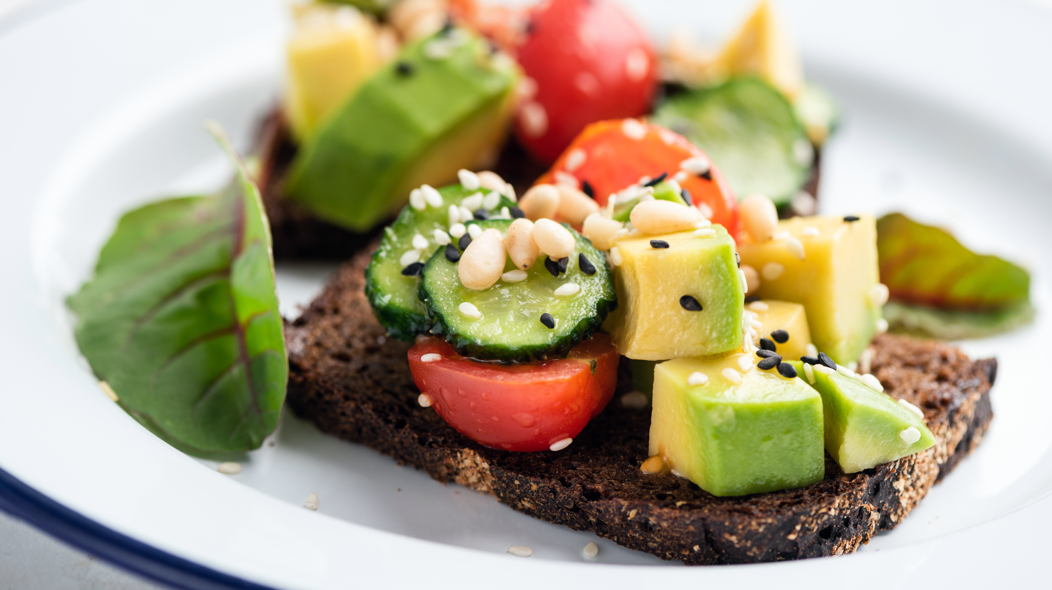
Lunch

Slide 43
Developing a game plan

Slide 44
Breakout groups

Slide 45
Components of Game Plan
Goals & Benchmarks
List any goals and benchmarks related to this particular game plan.
Rationale
Why is this game plan being written and implemented?
Currently Happening
List the things in the youth ministry that are already happening that would relate to this particular game plan.
Decisions
List any decisions that need to be made in order to implement this game plan.
Staff Responsibilities
List the responsibilities of the youth ministry staff related to this game plan.

Slide 46
Continued…
Volunteers Needed
List of all key volunteer positions created by this game plan.
Volunteer Responsibilities
Clearly indicate the responsibilities of the volunteers
Calendar
List any events that are being created with this game plan that need to be added to the youth ministry calendar.
Database
List any particular database needs.
Other Roles
List any other roles that will be a part of implementing this game plan.

Slide 47
Final steps…
Implementation
List in order the steps to be taken to implement the game plan.
Timeline
Create a month-by-month timeline in which the game plan will be implemented.

Slide 48
break

Slide 50
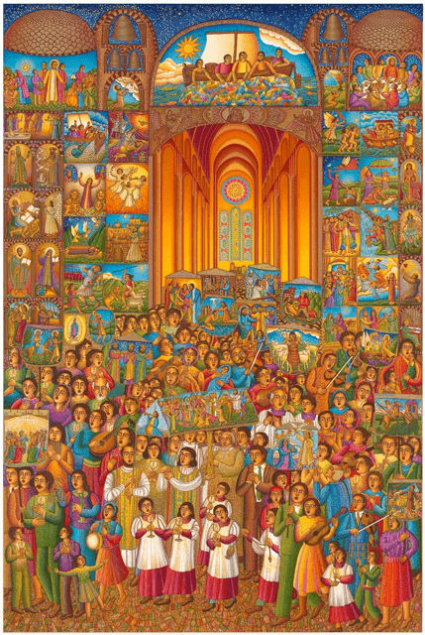
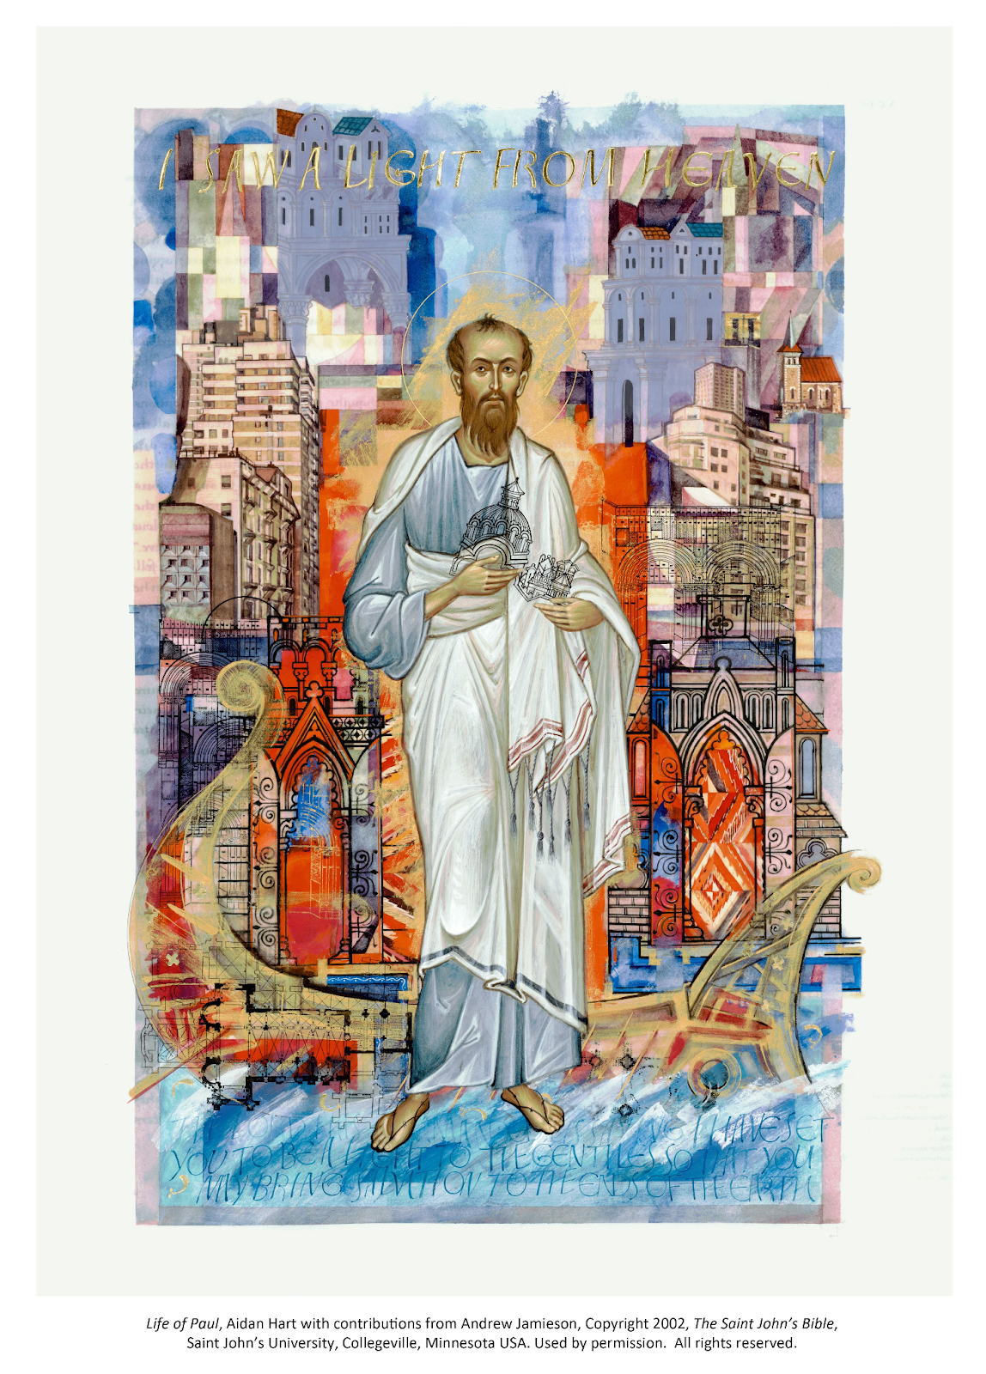
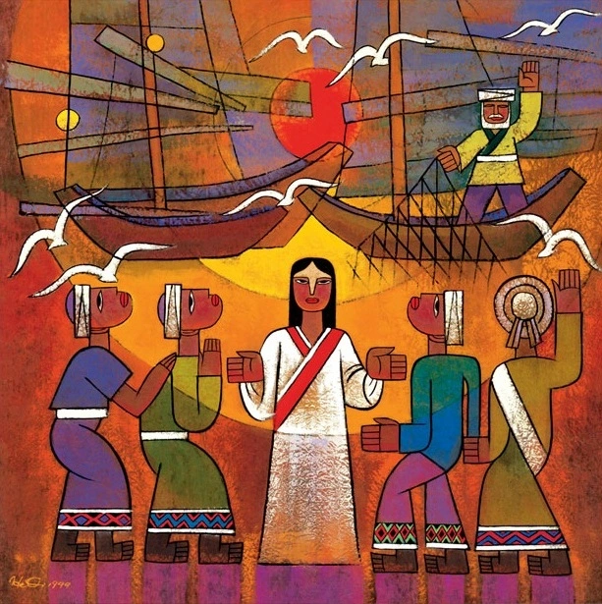
Visio divina
SEE
MEDITATE
PRAY

